Slide 1
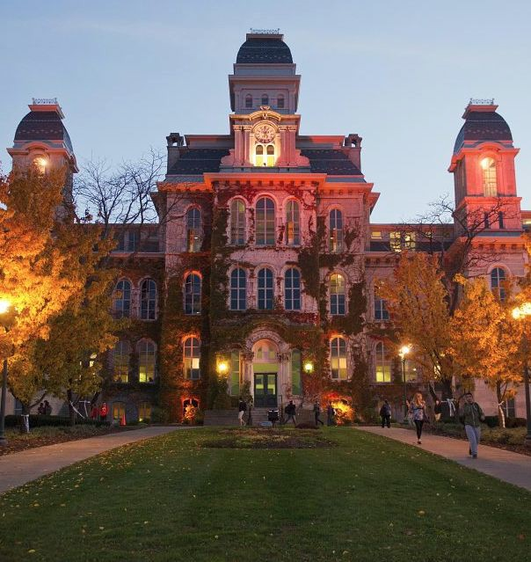

Master of Science
Applied Data Science
School of Information Studies
Portfolio Milestone
https://github.com/prasadkulkarni01/SyracuseUniversityDataScience
Prasad Kulkarni
928949766
11 June 2021

Slide 2
Introduction
The Applied Data Science program at Syracuse University’s School of Information Studies provides students the opportunity to collect, manage, analyze, and develop insights using data from a multitude of domains using various tools and techniques.
Reports and presentations were created in courses which exemplify the skills developed in the program including, but not limited to:
IST 659: Database Administration
IST 707: Data Analytics
IST 718: Big Data Analysis
MAR 653: Marketing Analytics

Slide 3

The Applied Data Science Program has seven Learning Objectives:
Describe a broad overview of the major practice areas in data science.
Collect and organize data.
Identify patterns in data via visualization, statistical analysis, and data mining.
Develop alternative strategies based on the data.
Develop a plan of action to implement the business decisions derived from the analyses.
Demonstrate communication skills regarding data and its analysis for relevant professionals in their organization.
Synthesize the ethical dimensions of data science practice.

Slide 4


IST 659
Database Administration:
Healthcare Database

Slide 5
IST 659: Database Administration
Introduction
Through studying Database Administration under the direction of Prof. John P Stinnett, a Healthcare Insurance Database was developed to store paid claims details which can provide ability to systematically access historical information for reporting purposes and risk analysis purposes. The database includes :
Member / Dependent
Claim
Provider
Payment / Final disposition

Slide 6
IST 659: Database Administration
Modeling, Table Creation, and Reporting
Conceptual and Logical models were developed to organize the relationships between the various members of the database.
SSMS was utilized to create and initially populate the tables.
Stored procedures were created to report various summary statistics.
Microsoft Access was used to facilitate bulk data entry and reporting.

Slide 7
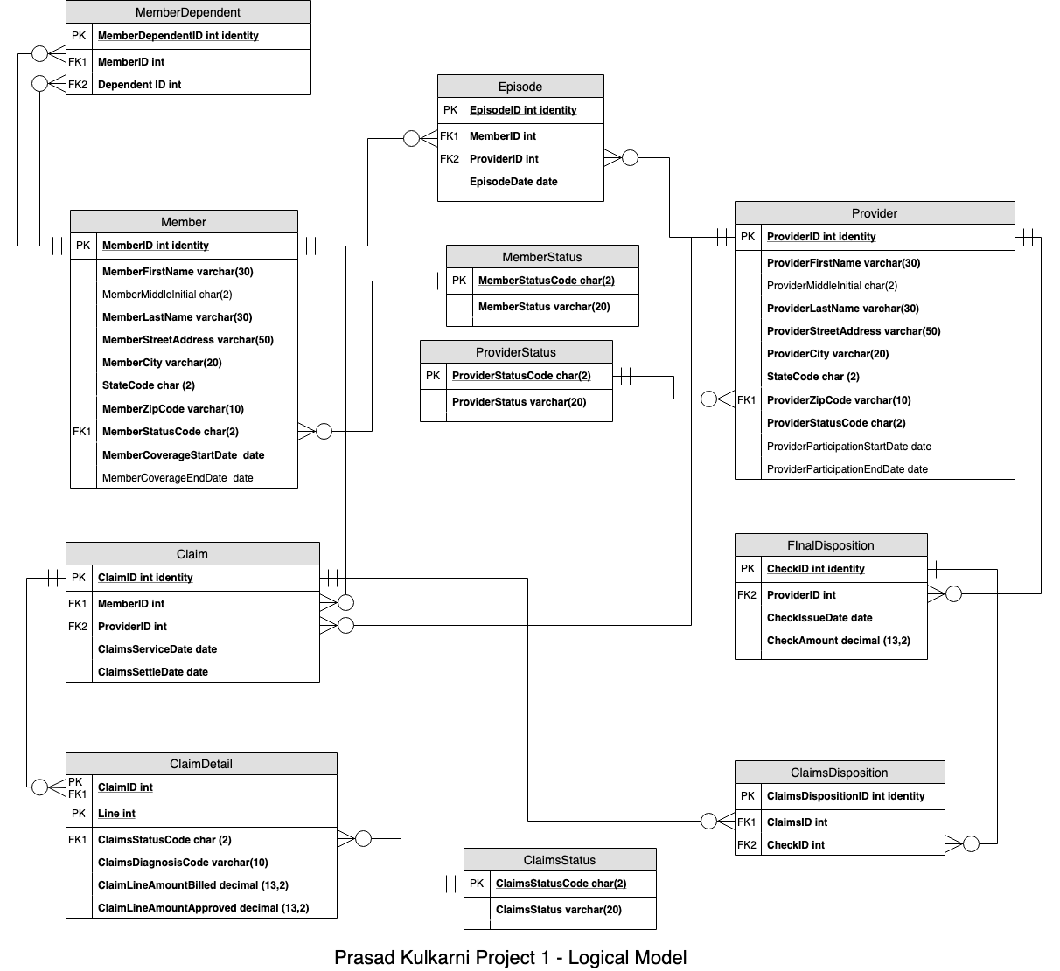
IST 659: Database Administration

Slide 8
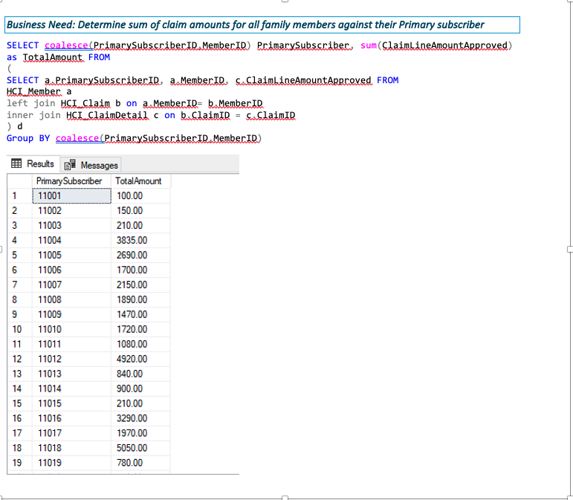
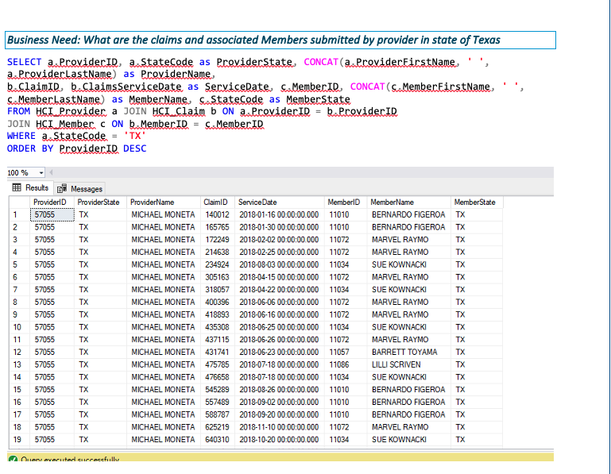
IST 659: Database Administration

Slide 9
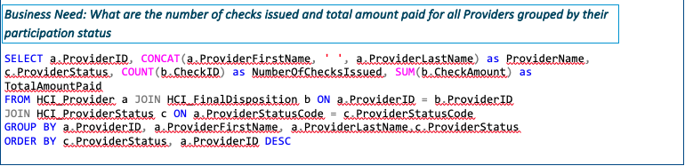
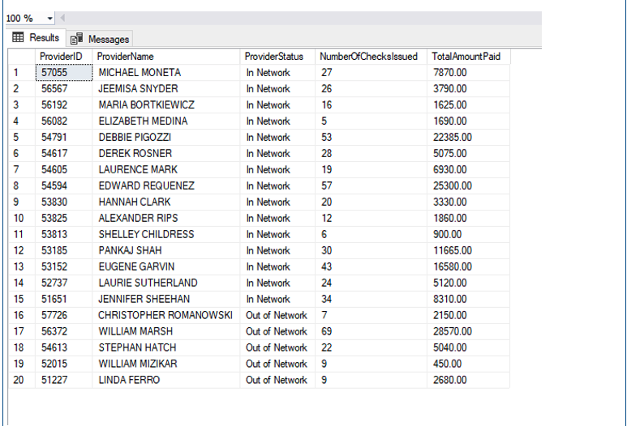
IST 659: Database Administration

Slide 10
IST 659: Database Administration
Reflection
After working extensively on this project, I realized that designing, creating and implementing a database requires much more strategic thinking. Consistent focus on simplifying user/application interaction, at the same time achieving necessary data integrity, data security, and concurrent handling through proper designing techniques (such as Normalization, Security measures etc.) are key factors in implementing operational database.
In first part, during initial stage I had thought about capturing patient and provider interactions through “Episodes” table but later realized that it will make current normalization structure between Member, Provider and Claims very complicated. Instead, this can be also be achieved by creating views for specific requirements post implementation.
In the final term of the program, additional study in more advanced database architectures will be explored in Advanced Database Management and Data Warehouse.

Slide 11


IST 707
Data Analytics:
NCAA Basketball Tournament
Predicting 2017 Winning Scores

Slide 12
IST 707: Data Analytics
Introduction
Through studying Data Analytics under the direction of Prof Lin , various data mining techniques were introduced which perform with varying precision and efficiency for applications in regression, classification, and clustering.
Random Forest, Support Vector Machine and Decision Tree Classification techniques were implemented to compare which model is capable of correctly predicting the score of the winning team for the 2017 women’s basketball season, an objective that is based on the Kaggle March Madness competition held in February 2017.
R Studio is leveraged to conduct analysis using data from Kaggle.

Slide 13
IST 707: Data Analytics
Methodology
The dataset was obtained from the 2018 Women’s NCAA March Madness Kaggle competition, and is conformed of 9 comma-separated value (CSV) files with a variety of data columns.
However, for the purpose of this project, only relevant columns were used to predict tournament results. Examples of variables that will be used include: season, day season started, day number, winning and losing teams, winning and losing team scores, seeds (for tournament games), number of overtimes played, cities were the game was played, and whether the winning team won at home, away, or on neutral ground.
Initially, we thought the best model would be the SVM, followed closely by the linear regression. It turns out that it was the other way round, with the SVM having a RMSE of 7.96, the linear regression a RMSE of 7.89, and the random forest a RMSE of 7.58.

Slide 14
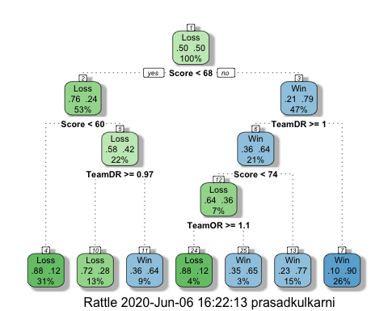
IST 707: Data Analytics

Slide 15
IST 707: Data Analytics
Reflection
Though these are just three of the models that we tested, we talked about building more models that could potentially improve the prediction.
Testing alternative strategies and weighing the benefits of each technique with respect to the data can reduce computation costs and provide the greatest precision.
This is an important distinction in a marketing analytics setting, which is magnified by the scale of the data.
With more heavy computation being done using services such as Azure, the consideration of computational costs is growing in significance.

Slide 16
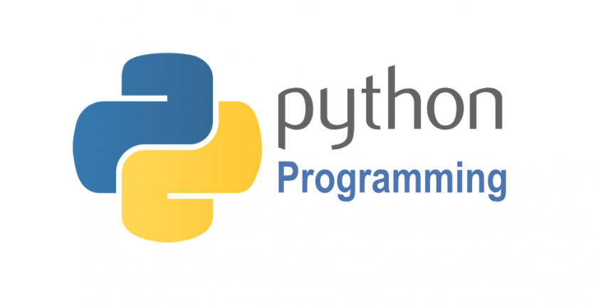
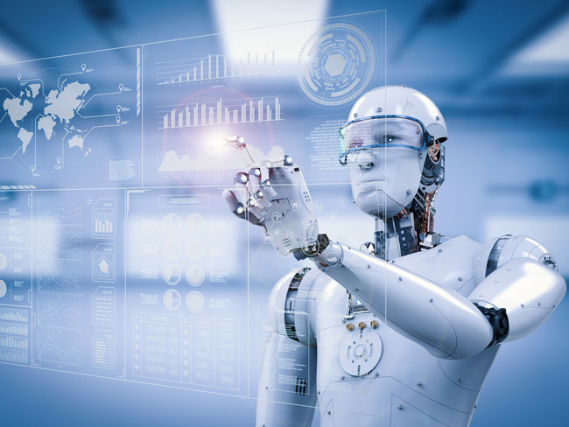

IST 718
Big Data Analysis:
Google Research Football with Manchester City F.C.
(A Kaggle Competition)

Slide 17
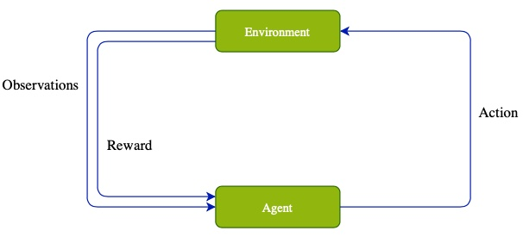
Google Football Components
Environment
Updates environment based on action.
Provides observations/rewards.
Agent
Based on observations, decides action.
Rule based, RL...
Observations
Players, ball information.
Reward
Scoring.
Moving closer to the goal.
Action
Long/short pass.
Shoot the ball.
Step
One cycle of environment -> Agent -> action.
One game is comprised of one or more steps.

Slide 18
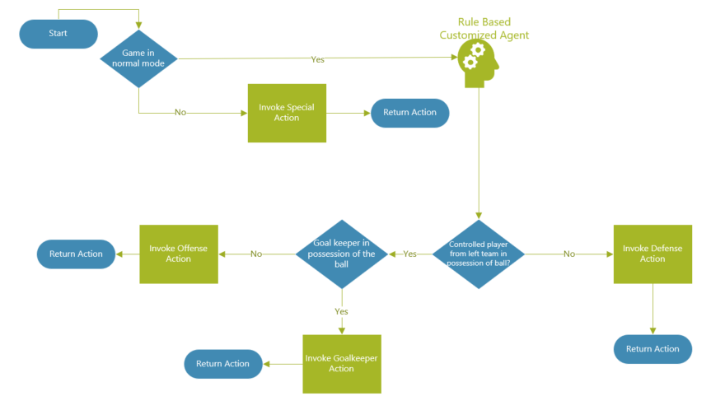
Rule Based Agent: Direct Coding Approach

Slide 19
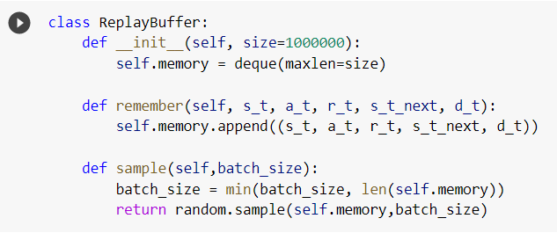
Neural Network
A neural network was designed using tensorflow and keras
Starting code was also found to assist in the model
Utilized a replay buffer, epsilon and Q-Value

Slide 20
Training the Model
Training the model involved running it through several iterations and using the previous Q- Value on as a starting point for the next.
Base Q-weights and epsilon are then established at the end of the training
This is where we get to adjust initial epsilon and Q-weights to tweak the model
We can also add weights to each layer independently

Slide 21
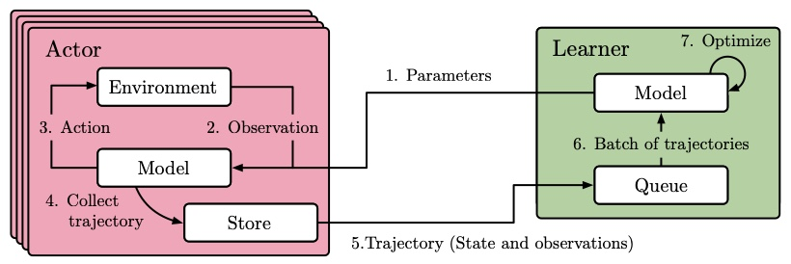
Reinforcement Learning: Impala Distributed Architecture
Unsupervised learning through experience.
Maximize cumulative rewards.
Football presents a perfect modern task.
Scoring is a rare event.
Complex environment.

Slide 22
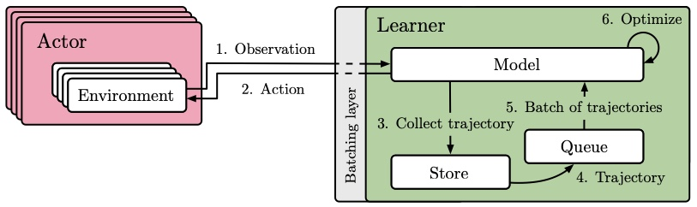
Reinforcement Learning: SEED RL Architecture
Improvements:
Single responsibility.
Ability to optimize for task.
Improved bandwidth.

Slide 23
RL Training
16 actors.
10 million steps trained.
3-layer Convolutional Neural Network.
ReLU activation function.
Adam optimizer.
0.00048 learning rate.
10 hours of training time.

Slide 24
Rule Based vs RL Agent
Rule Based Agent Vs RL Agent

Slide 25
Reflection:
Rule based.
Easy to reason about and inexpensive compute.
Limited agent expertise.
Neural Network
Great potential for agent skill.
Lack of framework for learning.
Reinforcement Learning
Closer to how humans learn.
More work to be done.
Learning from scratch every time.

Slide 26
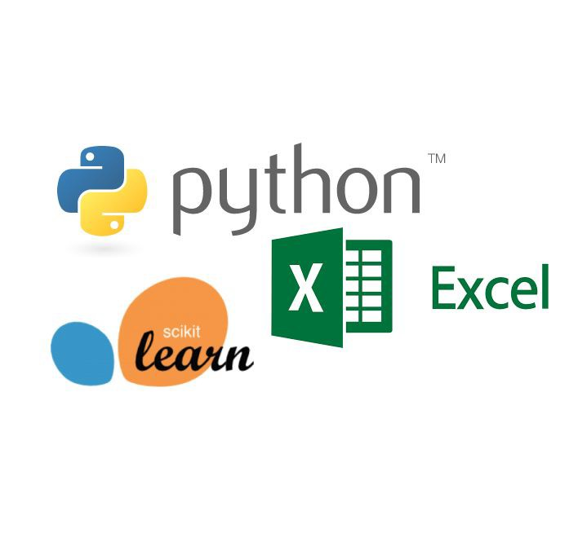
MAR 653
Marketing Analytics:
Complete Journey
K-Means Clustering & Apriori Rule Association For Development of Direct Mail Promotion

Slide 27
MAR 653: Marketing Analytics
Introduction
Through studying Marketing Analytics under the direction of Prof. Rajkumar Venkatesan, data mining concepts specific to marketing were introduced which inspired the final presentation.
Yearly transaction information for households from a grocery store was used to identify a target group of customers using K-Means Clustering.
An optimal promotional offer was then derived using Apriori Rule Association and Sensitivity Analysis for use in a Direct Mail Marketing Campaign.
Python was used for clustering and rule association, while Sensitivity Analysis and data exploration were conducted with Excel.

Slide 28
MAR 653: Marketing Analytics
Segmentation
This exercise involved exploring and cleaning the data prior to clustering.
Categorical columns are one-hot encoded, dropping one to avoid the dummy-variable trap.
Segmentation is completed using the items and pricing data, while profiling
is accomplished using demographic information such as:
Age
Income
Household Size
Marital Status
Number of Children
Considerations are made to exclude demographic data from segmentation to avoid introducing bias into the analysis.

Slide 29
MAR 653: Marketing Analytics
Optimal Cart Building
The selected cluster contained nearly 20% of the entire customer base and use coupons slightly more often than the average customer.
Three optimal carts are developed using Apriori Rule Association and the items purchased by households in this cluster.
These items are selected such that when items from cart 1 are purchased, items from cart 2 have a discount applied.
This method has also been successfully implemented in predicting purchase behavior in an e-commerce setting, which also uses a target subset of their customers to improve the expected result.⁹

Slide 30
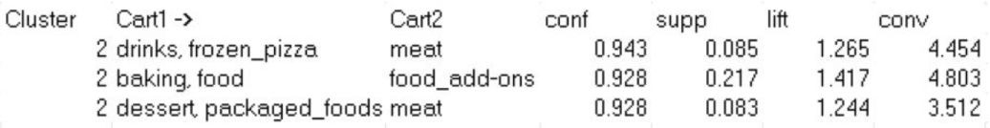
MAR 653: Marketing Analytics
Optimal Discount Calculation
The optimal coupon discount is calculated using the average discounts applied previously and varying the percent discount to not exceed a $10,000 liability margin.
This resulted in an expected 137% increase in gross revenue for the affected products, with a $4,000 reduction in liability from other recurring promotions.
The promotion was recommended to be ran for one month to measure the participation from the targeted group, with well defined goals and expectations to measure success.

Slide 31
MAR 653: Marketing Analytics
Reflection
This project provided the opportunity to organize and analyze transaction information using data mining techniques, as well as visualization to identify patterns for customer targeting.
It was necessary to develop a plan of action to quantify the insights developed in this analysis, which translates to actionable business decisions.
This application allowed data to guide the analysis, requiring alternative strategies to be developed as observations were made within the data.
Ethical considerations were made with respect to segmentation, using demographic information to profile previous behavior.

Slide 32
Learning Objectives
This portfolio has demonstrated successful implementation of the program’s learning objectives and the major practice areas of data science. Each application involved an increasing level of complexity, and characterized the progression of these skills.
Data was collected and managed using web scraping and APIs in conjunction with database solutions to be analyzed using statistical methods and data mining techniques for tasks such as regression, classification, or clustering.
IST 659 collected and managed data using database solutions.⁴
IST 707 analyzed data using Naive Bayes and Decision Tree classification techniques.
IST 718 Predictive analysis using rule based, Neural network and reinforcement learning approach.⁶
MAR 653 utilized K-Means Clustering, Apriori Rule Association, and Sensitivity Analysis.

Slide 33
Learning Objectives
Various Data Visualizations were paired with clustering techniques to identify patterns which directed the respective analyses; actionable recommendations were developed to reflect tangible business decisions. As a result, it was necessary to develop alternative methods based on the outcome of each step in the analyses.
MAR 653 was directed solely by the results of the analyses, where a target customer group was first identified, followed by the selection of frequently purchased items within this group, and finally the calculation of the suggested discounts based on these selected items. This allows for confident recommendations to be delivered which translate to tangible business decisions.

Slide 34
Learning Objectives
Communications skills were displayed in the organization and delivery of insights, expressing them in terms which could be simply understood and acted upon.
The ethical dimensions of data science practice were displayed and considered when analyzing PII from external sources.
MAR 653 required the consideration of demographic information which was excluded from segmentation, being used only for profiling. This reduces the possibility of introducing bias into the analysis.
These projects are representative of the successful execution of the learning objectives and have developed the necessary skills for practice in the field of data science.

Slide 35
Conclusion
Syracuse University’s School of Information Studies provides students the opportunity to synthesize the collection, management, and analysis of data, as well as the delivery of actionable insights using various data science techniques.
Skills learned in the program have developed a multifaceted approach to solving structured and unstructured data problems with increasing complexity.
It has cultivated strategies which improve organizational efficiency.
The program has fostered a practice of transparency, reproducibility, and ethical data management which promotes integrity within an organization’s analytics team.
Using the skills learned in the Applied Data Science program, data scientists are equipped with the ability to tackle a wide range of problems and the resources to explain observations to a variety of stakeholders and business professionals.

Slide 36
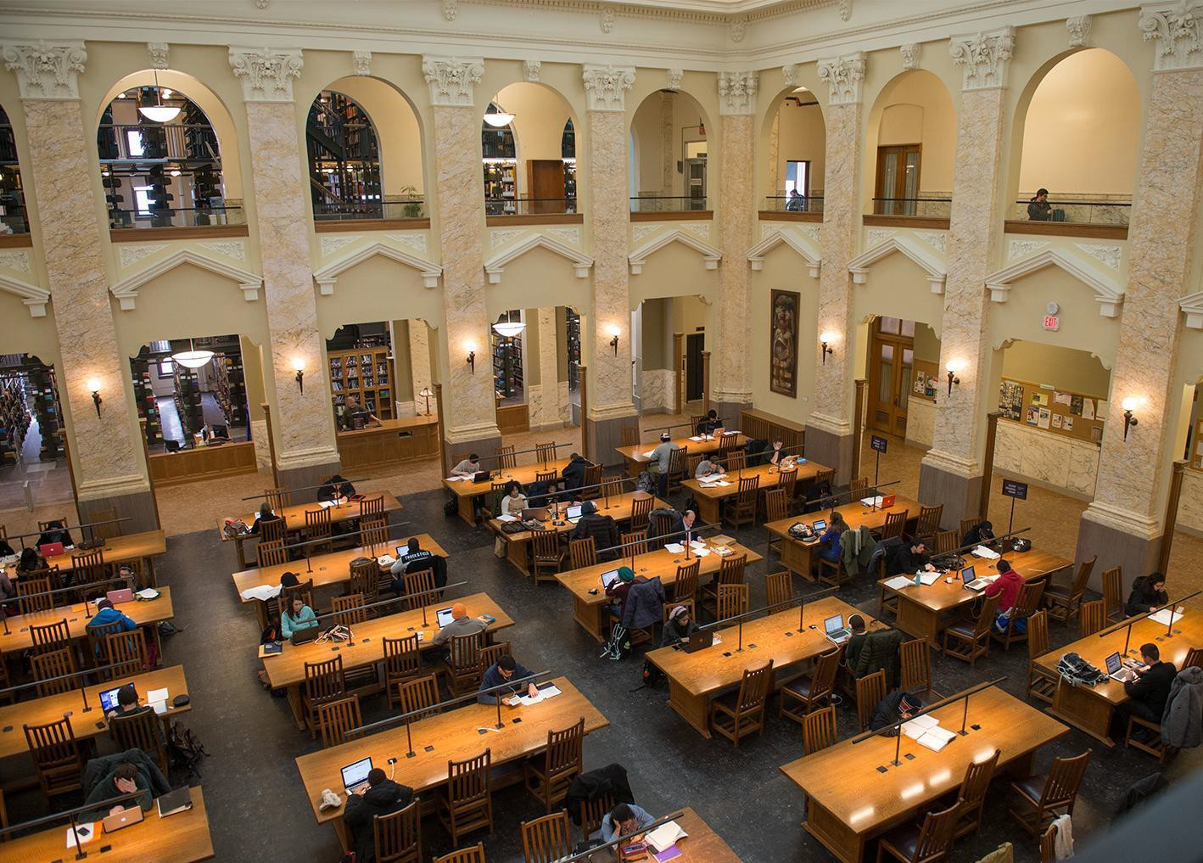
Thank You!
Template Retrieved from:
https://www.syracuse.edu/about/brand/visual-identity/powerpoint-templates/

Slide 37
References
Prasad Kulkarni IST 659: Database Administration. Retrieved from https://github.com/prasadkulkarni01/SyracuseUniversityDataScience/tree/main/IST%20659
Prasad Kulkarni IST 707: Data Analytics. Retrieved from https://github.com/prasadkulkarni01/SyracuseUniversityDataScience/tree/main/IST%20707
Prasad Kulkarni IST 718: Big Data Analytics. Retrieved from https://github.com/prasadkulkarni01/SyracuseUniversityDataScience/tree/main/IST%20718
Prasad Kulkarni MAR 653: Marketing Analytics. Retrieved from https://github.com/prasadkulkarni01/SyracuseUniversityDataScience/tree/main/MAR%20653

Slide 38
Image Sources
Kaggle[PNG]. (n.d.). https://aezmdcb0d81bgava-zippykid.netdna-ssl.com/wp-content/uploads/2017/03/Kaggle-logo.png.
Mallet[PNG]. (n.d.). http://mallet.cs.umass.edu/logo3.png.
Microsoft Access[JPG]. (n.d.). https://www.microsoft.com/en-us/microsoft-365/blog/wp-content/uploads/sites/2/migrated-images/53/8787.CAROUSEL_Access_260x146.jpg.
Microsoft Excel[PNG]. (n.d.). https://gravitatesolutions.com/refresh/wp-content/uploads/2015/09/connector-excel-logo.png.
Python[PNG]. (n.d.). https://www.python.org/static/community_logos/python-logo-master-v3-TM.png.
R Studio[PNG]. (n.d.). https://www.dcu.ie/sites/default/files/software/r_studio.png.
SciKit Learn[PNG]. (n.d.). https://scikit-learn.org/stable/_images/scikit-learn-logo-notext.png.
SQL Server[SVG]. (n.d.). https://cdn.worldvectorlogo.com/logos/microsoft-sql-server.svg.
Tableau[PNG]. (n.d.). https://www.sheerid.com/wp-content/uploads/2016/10/tableau-logo.png.
Twitter[JPG]. (n.d.). Https://static01.nyt.com/images/2014/08/10/magazine/10wmt/10wmt-articleLarge-v4.jpg?quality=75&auto=webp&disable=upscale.

